Slide 1
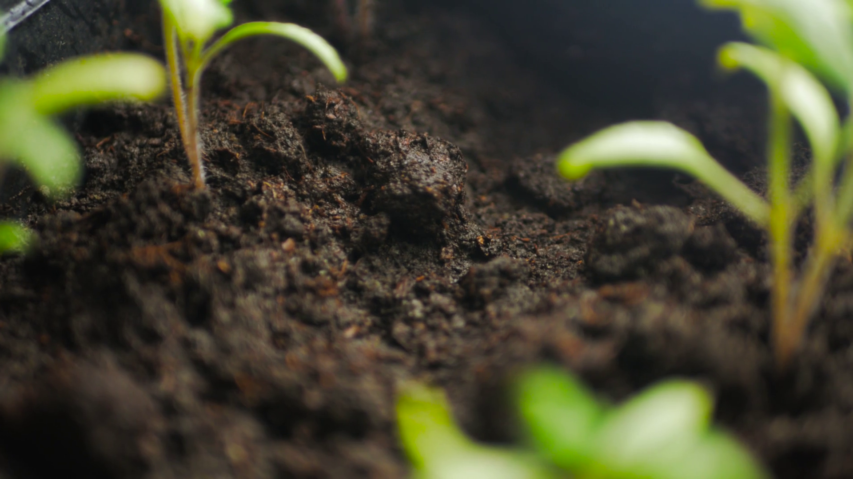
Let the Soil Play its Simple Part
By Greg Sakowski
Image courtesy:
https://www.storyblocks.com/video/stock/close-up-of-young-plant-growing-from-soil-background-low-angle-view-hiw506dfgjese0pf0
Notes:
My name is Greg Sakowski and my project is: Let the Soil Play its Simple Part

Slide 2
Background
Who can benefit the most from converting to regenerative agriculture?
Focusing on two benefits of regenerative farming:
Removing Chemical and Fertilizer inputs
Cover cropping for water retention
Three underlying questions:
Which areas have the highest risk of drought?
Which areas have the highest costs of chemicals and fertilizer?
Which factors are most important for predicting drought?
Notes:
This project started with the question Who can benefit the most from converting to regenerative agriculture?
Regenerative agriculture can mean different things, but the benefits I focused on were
Swapping manufactured chemical inputs like pesticides for biodiversity, and manufactured fertilizer for manure
Cover cropping to enhance water infiltration and improve drought mitigation
I had three underlying questions I wanted to address over the course of analysis
Which areas have the highest risk of drought?
Which areas have the highest costs of chemicals and fertilizer?
Which factors are most important for predicting drought?

Slide 3



Data Acquisition, Wrangling and Analysis
Primary Data Sources:
Drought levels from US Drought Monitor
Weather data from the National Oceanic and Atmospheric Association
USDA Census of Agriculture
Final dataset:
County-level data
Narrowed to 15 states
For the years 2002, 2007, 2012, 2017
Target Variable:
“In drought” - when the majority of a county’s area is experiencing drought conditions for the observed week.
Notes:
I gathered data from three primary sources and my final dataset had weekly, county-level data for the 15 most agriculturally productive states for the years 2002, 7, 12, and 17.
I established my target variable as the “in drought” condition, when the majority of a county is experiencing drought for the observed week. During my analysis I found several states with clear drought risks…

Slide 4
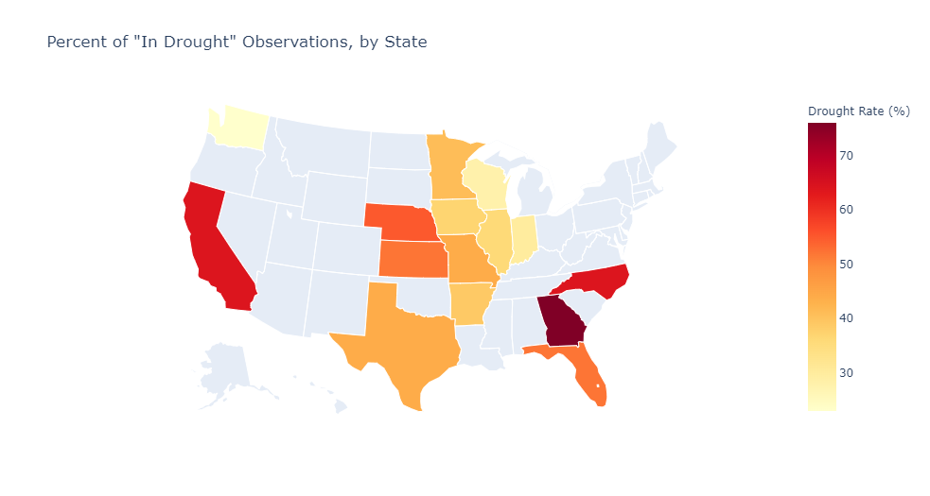
Notes:
Georgia had the highest rate of drought at 74%. North Carolina and California were tied for second with 64% drought.
Turning to examine costs by state…

Slide 5
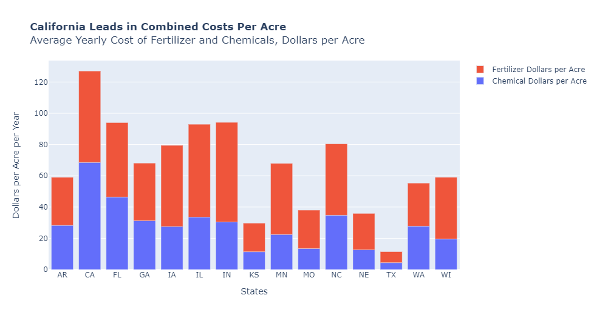
Notes:
California is by far the frontrunner in total costs, averaging $127 per acre for fertilizer and chemical expenses
So, with states with high risks and high rewards in mind, I moved on to modeling…

Slide 6
Modeling Drought
Four Models that are focused on interpretability
Two standard Classifiers: Logistic Regression and Decision Tree
Two Ensemble Classifiers: Random Forest and Gradient Boosting
Feature Selection: Removed 5 variables, Converted 4 variables
Random Forest was the most successful with 94% accuracy.
Notes:
I wanted my models to be interpretable—I needed to be able to check what features were most important in predicting drought for a county. The most successful model I ran was the Random Forest at 94% accuracy
Going into modeling I had speculated if the combined chemical and fertilizer expenses feature would be predictive for drought…

Slide 7
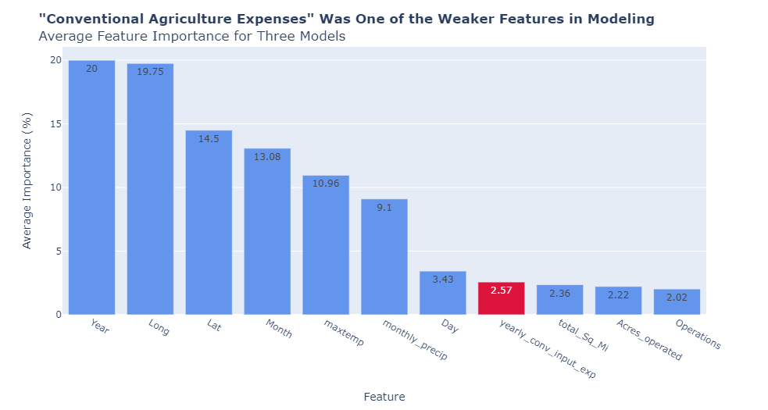
Notes:
However, the features that were most important were actually the year that the observation was made, and Longitude – the east to west coordinates of the observed county.
To summarize: we found states with high drought risk and high spending on chemicals and fertilizers and we know that areas that are clustered together longitudinally are likely to have similar drought conditions.
After some additional analysis I found a cluster of counties that would benefit the most from converting to regenerative agriculture…

Slide 8
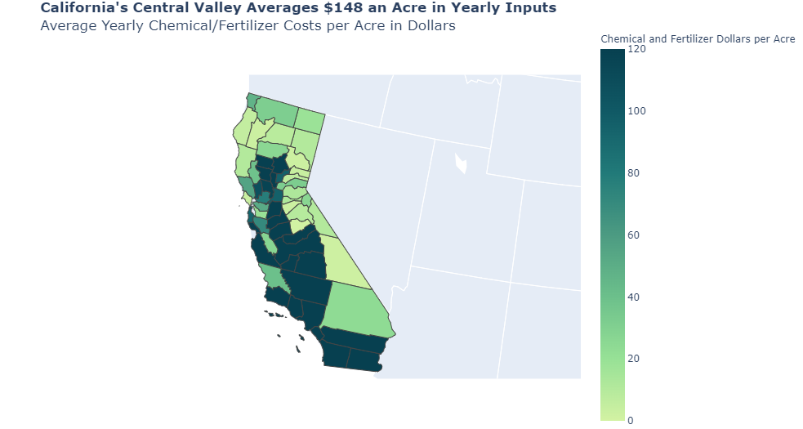
Notes:
California’s Central Valley.
It has a high drought risk of 63.4% and a high cost of chemical and fertilizer inputs, $148 an acre--almost triple the national average. Finally it is tightly clustered longitudinally--an important factor in my models.
And the Central Valley is highly productive--it makes up about 8% of the United States' total agricultural production.
The Central Valley can mitigate its high risk of drought and lower overhead costs by converting to regenerative agriculture and letting the soil play its simple part.

